Slide 1
Lecture 4
ASSOCIATIVE MEMORY

Slide 2
Introduction
In computing, memory is a device or system that is used to store information for immediate use.
Examples: RAM, ROM,PROM, EPROM etc.
Data is stored in form of words and each word is accessible by an address (address addressable memory).
With technology advancement, we come up with the need of very high speed memory….i.e. CAM (Content Addressable Memory).
Content-addressable memory (CAM) is a special type of computer memory used in certain very-high-speed searching applications.
It is also known as associative memory or associative storage and compares input search data against a table of stored data, and returns the address of matching data.

Slide 3
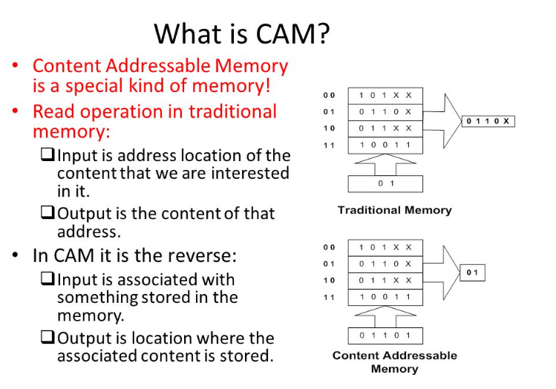
Associative memories/CAM can be implemented either by using feedforward or recurrent neural networks. Here we will only see feed forward implementation.

Slide 4
Some Terminologies
Hamming Distance
Training Algorithms for Pattern Association
  Hebb Rule
  Outer products Rule
April 2007

Slide 5
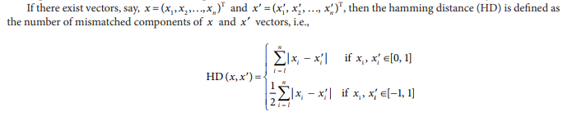
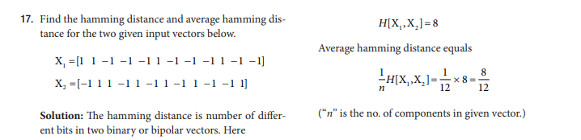
Hamming Distance
April 2007

Slide 6
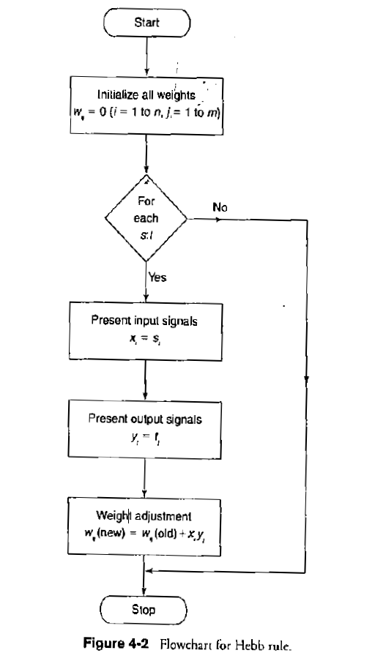
HEBB RULE: Used for finding weights of an associative memory neural net. The training vector pairs are denoted as s:t
April 2007

Slide 7
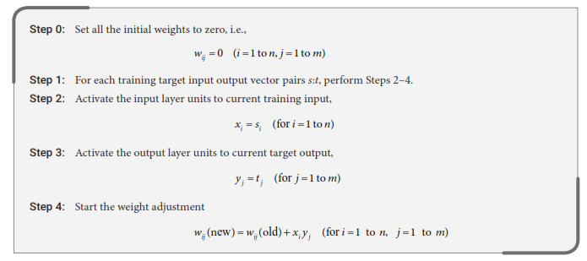
HEBB RULE ALGORITHM
April 2007

Slide 8
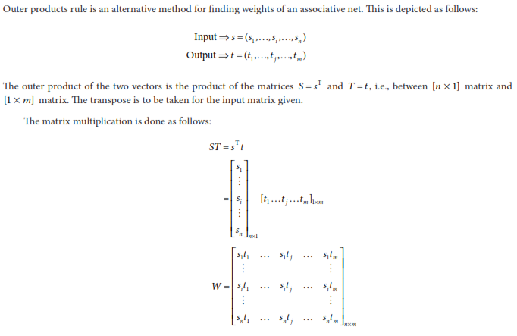
Outer Products Rule: alternative method for finding weights of an associative net
April 2007

Slide 9
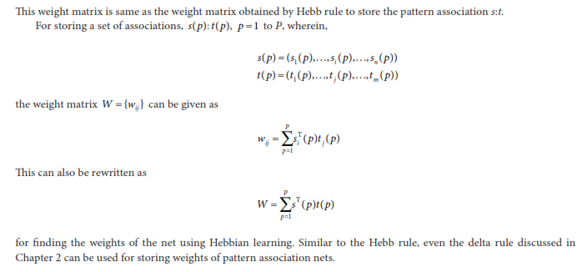
Comparing the results of Hebb Rule and Outer Product Rule
April 2007

Slide 10
TYPES OF ASSOCIATIVE MEMORY NETWORKS
Two types based on type of associations between i/p (s) and o/p (t)
  hetero-associative (s != t): relating two different patterns (s – input, t – target).
  auto-associative (s = t): relating parts of a pattern with other parts.
Definitions
  In the case of an autoassociative neural net, the training input and the target output vectors are the same.
  In case of a heteroassociative neural net, the training input and the target output vectors are different.

Slide 11
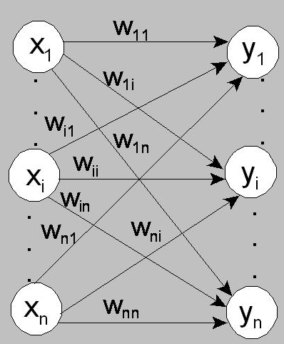
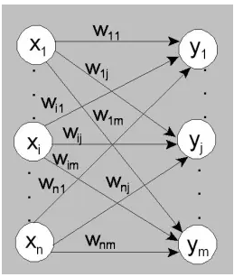
Architectures of associative memory:
AUTO-ASSOCIATIVE MEMORY
HETERO-ASSOCIATIVE MEMORY

Slide 12
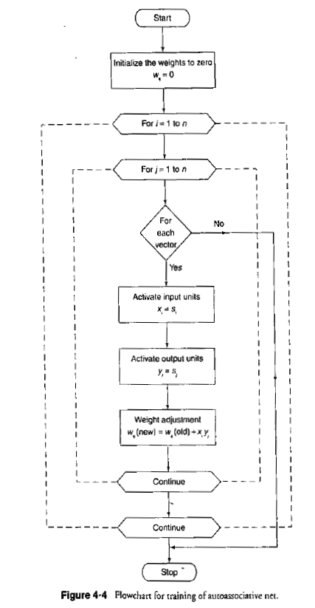
Flowchart for training process
(Autoassociative)
April 2007

Slide 13
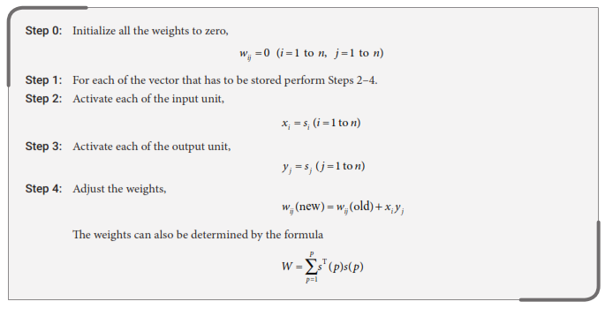
Training Algorithm: AUTO-ASSOCIATIVE MEMORY
April 2007

Slide 14
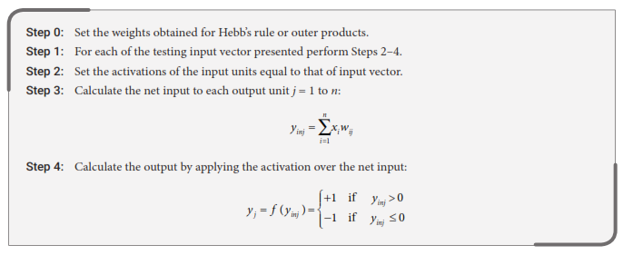
Testing Algorithm: AUTO-ASSOCIATIVE MEMORY
April 2007

Slide 15
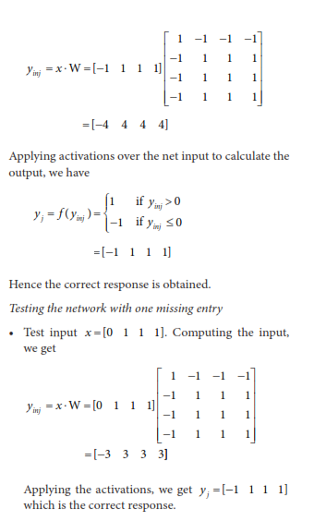
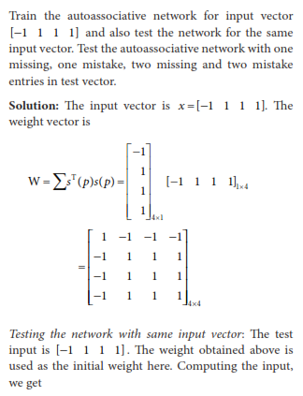
EXAMPLE
April 2007

Slide 16
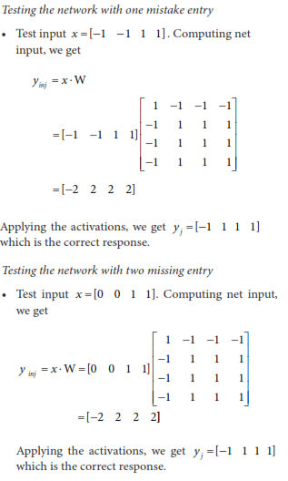
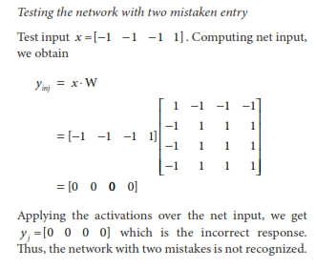
April 2007

Slide 17
Training Algorithm: HETERO-ASSOCIATIVE MEMORY
SAME AS THAT OF AUTO ASSOCIATIVE MEMORY NETWORK
April 2007

Slide 18
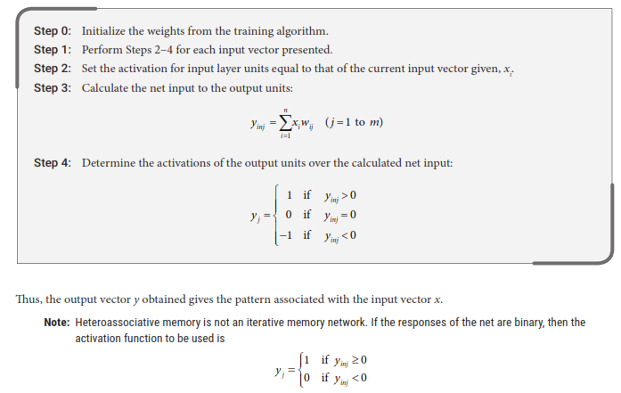
Testing Algorithm: HETERO-ASSOCIATIVE MEMORY
April 2007

Slide 19
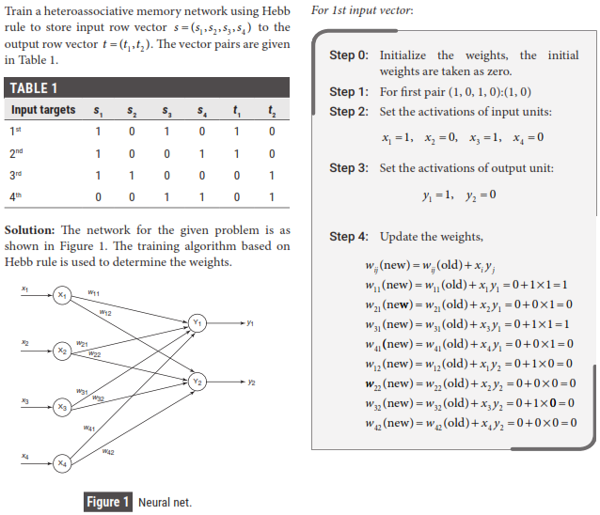
EXAMPLE
April 2007

Slide 20
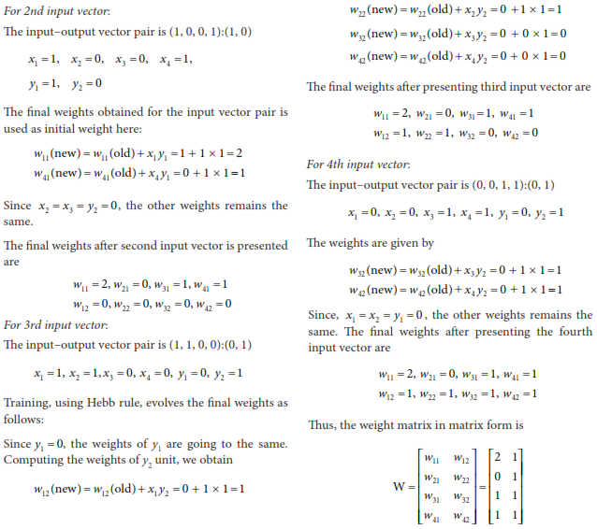
April 2007

